Slide 1

Link Layer Topology Discovery (LLTD) and Vista Network Map
David Roberts
Glenn Ward
Microsoft Windows Networking
© 2006 Microsoft Corporation. All rights reserved.
This presentation is for informational purposes only. Microsoft makes no warranties, express or implied, in this summary.

Slide 2

Agenda – LLTD / Network Map
Feature and Business Overview
Architecture & Protocol Details
Reference LLTD Implementation
  Porting Kit contents
Notes:
© 2006 Microsoft Corporation. All rights reserved. Microsoft, Windows, Windows Vista and other product names are or may be registered trademarks and/or trademarks in the U.S. and/or other countries.
The information herein is for informational purposes only and represents the current view of Microsoft Corporation as of the date of this presentation. Because Microsoft must respond to changing market conditions, it should not be interpreted to be a commitment on the part of Microsoft, and Microsoft cannot guarantee the accuracy of any information provided after the date of this presentation.
MICROSOFT MAKES NO WARRANTIES, EXPRESS, IMPLIED OR STATUTORY, AS TO THE INFORMATION IN THIS PRESENTATION.

Slide 3
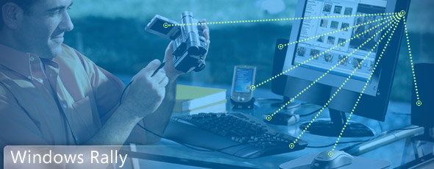
Windows® Rally™ Program
Access to Technologies
Simple Unified License
Technical Guidance
Notes:
© 2006 Microsoft Corporation. All rights reserved. Microsoft, Windows, Windows Vista and other product names are or may be registered trademarks and/or trademarks in the U.S. and/or other countries.
The information herein is for informational purposes only and represents the current view of Microsoft Corporation as of the date of this presentation. Because Microsoft must respond to changing market conditions, it should not be interpreted to be a commitment on the part of Microsoft, and Microsoft cannot guarantee the accuracy of any information provided after the date of this presentation.
MICROSOFT MAKES NO WARRANTIES, EXPRESS, IMPLIED OR STATUTORY, AS TO THE INFORMATION IN THIS PRESENTATION.

Slide 4
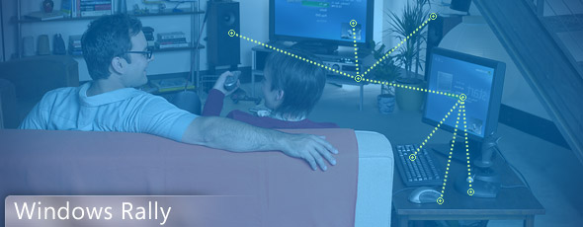
Windows® Rally™ Devices
Effortless to configure and maintain
Reliable and simple to manage
More secure and provide rich digital experiences
Notes:
© 2006 Microsoft Corporation. All rights reserved. Microsoft, Windows, Windows Vista and other product names are or may be registered trademarks and/or trademarks in the U.S. and/or other countries.
The information herein is for informational purposes only and represents the current view of Microsoft Corporation as of the date of this presentation. Because Microsoft must respond to changing market conditions, it should not be interpreted to be a commitment on the part of Microsoft, and Microsoft cannot guarantee the accuracy of any information provided after the date of this presentation.
MICROSOFT MAKES NO WARRANTIES, EXPRESS, IMPLIED OR STATUTORY, AS TO THE INFORMATION IN THIS PRESENTATION.

Slide 5
Windows Rally Experiences
Windows Rally Technologies
Applications
Management Interfaces
Device Specific Drivers
Plug and Play Extensions
Quality of Service
LLTD: QoS Extensions
Network Map
LLTD: Topology Map
Wireless Setup
Windows Connect Now
Discovery
Function
Discovery
AV Devices
UPnP
Networked
Devices
Device Profile
for Web Services
IP Network
(IPv4, IPv6)
Ethernet/Wireless
Windows Rally Experiences
Windows Rally Technologies
Notes:
© 2006 Microsoft Corporation. All rights reserved. Microsoft, Windows, Windows Vista and other product names are or may be registered trademarks and/or trademarks in the U.S. and/or other countries.
The information herein is for informational purposes only and represents the current view of Microsoft Corporation as of the date of this presentation. Because Microsoft must respond to changing market conditions, it should not be interpreted to be a commitment on the part of Microsoft, and Microsoft cannot guarantee the accuracy of any information provided after the date of this presentation.
MICROSOFT MAKES NO WARRANTIES, EXPRESS, IMPLIED OR STATUTORY, AS TO THE INFORMATION IN THIS PRESENTATION.

Slide 6
Problem Statement
Users have difficulties troubleshooting issues on their network
YOU have few support tools for your device and/or service
Home Networks growing in sophistication
  Was: Internet Sharing for email, Web surfing
  Now and future: streaming from WAN, cross-home Media Delivery
  Latency-sensitive Broadband Services: IPTV, VoIP, Gaming
Unrealized scenarios -> product returns, smaller TAM
  Home Networking complexity calls for better infrastructure tools
Notes:
© 2006 Microsoft Corporation. All rights reserved. Microsoft, Windows, Windows Vista and other product names are or may be registered trademarks and/or trademarks in the U.S. and/or other countries.
The information herein is for informational purposes only and represents the current view of Microsoft Corporation as of the date of this presentation. Because Microsoft must respond to changing market conditions, it should not be interpreted to be a commitment on the part of Microsoft, and Microsoft cannot guarantee the accuracy of any information provided after the date of this presentation.
MICROSOFT MAKES NO WARRANTIES, EXPRESS, IMPLIED OR STATUTORY, AS TO THE INFORMATION IN THIS PRESENTATION.
Users have difficulties troubleshooting issues on their network
Multiple points of failure
Requires technical skill set to fix
Tedious to check power, connectivity, link integrity to discover issues
Remote support effectiveness limited by lack of network connectivity
Difficult vendor / ISP support experience
Takes up time and generates user frustration
Cannot properly describe topology to support technicians
Erodes customer satisfaction and trust
Expensive for vendors to support
Blame the issue on the wrong device; may result in product return!
Home Networks growing in sophistication
Intra-Home Media Delivery
Broadband Services: IPTV, VoIP

Slide 7

Solved via Vista Network Map / LLTD
LLTD – Link Layer Topology Discovery
Discovery, Topology and Diagnostics, below Internet Layer
No Dependency on NID intelligence to function
  Detect Legacy Hub, Switch, AP, Bridge, etc.
Ensures correct problem isolation
  Unplugged cables, broken links; removed, powered off, or malfunctioning devices
  Provides baseline network image
  Removes tediousness of diagnostic process
  Reports but is not dependent on any IP network connections
Notes:
© 2006 Microsoft Corporation. All rights reserved. Microsoft, Windows, Windows Vista and other product names are or may be registered trademarks and/or trademarks in the U.S. and/or other countries.
The information herein is for informational purposes only and represents the current view of Microsoft Corporation as of the date of this presentation. Because Microsoft must respond to changing market conditions, it should not be interpreted to be a commitment on the part of Microsoft, and Microsoft cannot guarantee the accuracy of any information provided after the date of this presentation.
MICROSOFT MAKES NO WARRANTIES, EXPRESS, IMPLIED OR STATUTORY, AS TO THE INFORMATION IN THIS PRESENTATION.

Slide 8
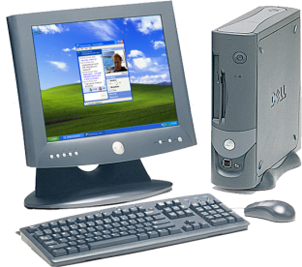
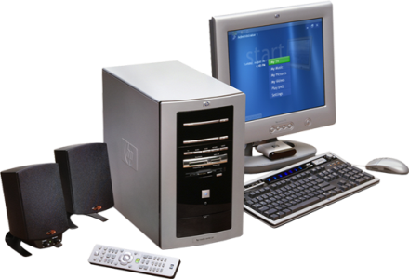
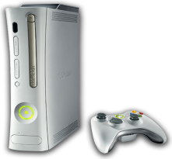
Where is the problem?
Currently when a network problem
occurs the user sees something like this:
Other devices in the home network
Dad’s PC
Destination unreachable
Xbox
Kid’s PC
Notes:
© 2006 Microsoft Corporation. All rights reserved. Microsoft, Windows, Windows Vista and other product names are or may be registered trademarks and/or trademarks in the U.S. and/or other countries.
The information herein is for informational purposes only and represents the current view of Microsoft Corporation as of the date of this presentation. Because Microsoft must respond to changing market conditions, it should not be interpreted to be a commitment on the part of Microsoft, and Microsoft cannot guarantee the accuracy of any information provided after the date of this presentation.
MICROSOFT MAKES NO WARRANTIES, EXPRESS, IMPLIED OR STATUTORY, AS TO THE INFORMATION IN THIS PRESENTATION.

Slide 9
Where is the problem?
With LLTD
the user can see:
switch
HUB
Dad’s PC
Hub needs to be reconnected
Xbox
Kid’s PC
Knowing the topology allows error messages to be more meaningful
Notes:
© 2006 Microsoft Corporation. All rights reserved. Microsoft, Windows, Windows Vista and other product names are or may be registered trademarks and/or trademarks in the U.S. and/or other countries.
The information herein is for informational purposes only and represents the current view of Microsoft Corporation as of the date of this presentation. Because Microsoft must respond to changing market conditions, it should not be interpreted to be a commitment on the part of Microsoft, and Microsoft cannot guarantee the accuracy of any information provided after the date of this presentation.
MICROSOFT MAKES NO WARRANTIES, EXPRESS, IMPLIED OR STATUTORY, AS TO THE INFORMATION IN THIS PRESENTATION.

Slide 10
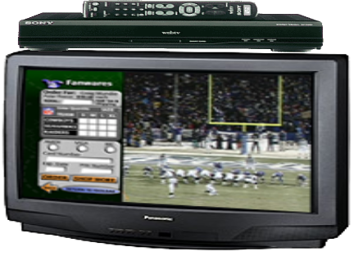
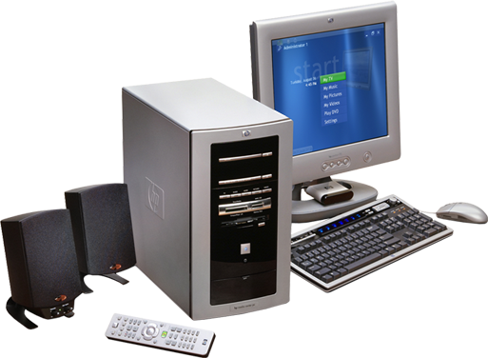
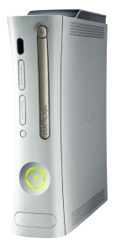
Identify Why Video has issues
HUB
Media server
bottleneck?
Knowing the topology allows accurate determination of which resources in the home network are shared, and thus potential bottlenecks.
Notes:
© 2006 Microsoft Corporation. All rights reserved. Microsoft, Windows, Windows Vista and other product names are or may be registered trademarks and/or trademarks in the U.S. and/or other countries.
The information herein is for informational purposes only and represents the current view of Microsoft Corporation as of the date of this presentation. Because Microsoft must respond to changing market conditions, it should not be interpreted to be a commitment on the part of Microsoft, and Microsoft cannot guarantee the accuracy of any information provided after the date of this presentation.
MICROSOFT MAKES NO WARRANTIES, EXPRESS, IMPLIED OR STATUTORY, AS TO THE INFORMATION IN THIS PRESENTATION.

Slide 11
Reconfigure to Improve Performance
HUB
Media server
Having problems?
HUB
Try this!
Knowing the topology allows guidance to be given on how to connect hardware devices and fix networking problems!
Notes:
© 2006 Microsoft Corporation. All rights reserved. Microsoft, Windows, Windows Vista and other product names are or may be registered trademarks and/or trademarks in the U.S. and/or other countries.
The information herein is for informational purposes only and represents the current view of Microsoft Corporation as of the date of this presentation. Because Microsoft must respond to changing market conditions, it should not be interpreted to be a commitment on the part of Microsoft, and Microsoft cannot guarantee the accuracy of any information provided after the date of this presentation.
MICROSOFT MAKES NO WARRANTIES, EXPRESS, IMPLIED OR STATUTORY, AS TO THE INFORMATION IN THIS PRESENTATION.

Slide 12
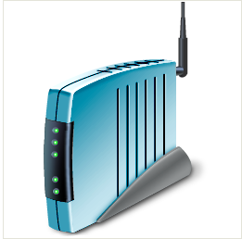
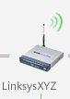
Business Value
Raise visibility, perceived value of networks and IP devices!
  No longer plumbing component
Offer exposure to devices that participate
Message Device Capabilities
  Identified in UI
  Give credit (good / bad) where due
Provide you with opportunity to showcase your:
  Industrial Design
  Brand
  Device Capabilities

Slide 13
LLTD Architecture Overview
© 2005 Microsoft Corporation. All rights reserved.
This presentation is for informational purposes only. Microsoft makes no warranties, express or implied, in this summary.

Slide 14
How does it work?
Mapper finds all the responders
Mapper asks the responders to send probes
Mapper asks responders which probes they saw
Mapper deduces shape of network
QoS analysis uses packet timing
Topology does not use timing; packet flow only
Notes:
© 2006 Microsoft Corporation. All rights reserved. Microsoft, Windows, Windows Vista and other product names are or may be registered trademarks and/or trademarks in the U.S. and/or other countries.
The information herein is for informational purposes only and represents the current view of Microsoft Corporation as of the date of this presentation. Because Microsoft must respond to changing market conditions, it should not be interpreted to be a commitment on the part of Microsoft, and Microsoft cannot guarantee the accuracy of any information provided after the date of this presentation.
MICROSOFT MAKES NO WARRANTIES, EXPRESS, IMPLIED OR STATUTORY, AS TO THE INFORMATION IN THIS PRESENTATION.

Slide 15

Behaviour: hub and switch
Hub is stateless and floods packets
Switch has state and learns source addresses
Consider three interfaces and this sequence …
  A sends a packet to C
    Received at B too
  C sends a packet to A
  A sends another packet to C
    Not received at B
A
C
A
B
C
Notes:
© 2006 Microsoft Corporation. All rights reserved. Microsoft, Windows, Windows Vista and other product names are or may be registered trademarks and/or trademarks in the U.S. and/or other countries.
The information herein is for informational purposes only and represents the current view of Microsoft Corporation as of the date of this presentation. Because Microsoft must respond to changing market conditions, it should not be interpreted to be a commitment on the part of Microsoft, and Microsoft cannot guarantee the accuracy of any information provided after the date of this presentation.
MICROSOFT MAKES NO WARRANTIES, EXPRESS, IMPLIED OR STATUTORY, AS TO THE INFORMATION IN THIS PRESENTATION.

Slide 16
Sending Probes
We send you an “emit” command
  List of packets we want you to send (in order)
You check it
  Any probe we ask you to send should not steal another machine’s MAC address. Must be LLTD OUI or own address.
Cant be used to amplify an attack
  Using “charge” we will send you as many packets as we ask you to send for us.
You may receive many emit commands in the course of a map
Notes:
© 2006 Microsoft Corporation. All rights reserved. Microsoft, Windows, Windows Vista and other product names are or may be registered trademarks and/or trademarks in the U.S. and/or other countries.
The information herein is for informational purposes only and represents the current view of Microsoft Corporation as of the date of this presentation. Because Microsoft must respond to changing market conditions, it should not be interpreted to be a commitment on the part of Microsoft, and Microsoft cannot guarantee the accuracy of any information provided after the date of this presentation.
MICROSOFT MAKES NO WARRANTIES, EXPRESS, IMPLIED OR STATUTORY, AS TO THE INFORMATION IN THIS PRESENTATION.

Slide 17
Receiving Probes
If you see a probe you keep a note of it
  You may have to keep a lot of probes
We will send you a “query” command
You tell us which probes you’ve seen
You may receive many query commands in the course of a map
Notes:
© 2006 Microsoft Corporation. All rights reserved. Microsoft, Windows, Windows Vista and other product names are or may be registered trademarks and/or trademarks in the U.S. and/or other countries.
The information herein is for informational purposes only and represents the current view of Microsoft Corporation as of the date of this presentation. Because Microsoft must respond to changing market conditions, it should not be interpreted to be a commitment on the part of Microsoft, and Microsoft cannot guarantee the accuracy of any information provided after the date of this presentation.
MICROSOFT MAKES NO WARRANTIES, EXPRESS, IMPLIED OR STATUTORY, AS TO THE INFORMATION IN THIS PRESENTATION.

Slide 18
Finding your responder
We send out a Discover
You send back a Hello
You do not send the Hello immediately
Execute scalability solution called BAND
Notes:
© 2006 Microsoft Corporation. All rights reserved. Microsoft, Windows, Windows Vista and other product names are or may be registered trademarks and/or trademarks in the U.S. and/or other countries.
The information herein is for informational purposes only and represents the current view of Microsoft Corporation as of the date of this presentation. Because Microsoft must respond to changing market conditions, it should not be interpreted to be a commitment on the part of Microsoft, and Microsoft cannot guarantee the accuracy of any information provided after the date of this presentation.
MICROSOFT MAKES NO WARRANTIES, EXPRESS, IMPLIED OR STATUTORY, AS TO THE INFORMATION IN THIS PRESENTATION.

Slide 19
Your device Information
Some information goes in Hello
  Roughly what we need to know to do the map
Some is queried using QueryLargeTlv
  Roughly what we need to show the map
Larger icon is carried by JumboTLV
Notes:
© 2006 Microsoft Corporation. All rights reserved. Microsoft, Windows, Windows Vista and other product names are or may be registered trademarks and/or trademarks in the U.S. and/or other countries.
The information herein is for informational purposes only and represents the current view of Microsoft Corporation as of the date of this presentation. Because Microsoft must respond to changing market conditions, it should not be interpreted to be a commitment on the part of Microsoft, and Microsoft cannot guarantee the accuracy of any information provided after the date of this presentation.
MICROSOFT MAKES NO WARRANTIES, EXPRESS, IMPLIED OR STATUTORY, AS TO THE INFORMATION IN THIS PRESENTATION.

Slide 20
LLTD Porting Kit and Sample Code
Glenn Ward
Group Partner Manager
© 2005 Microsoft Corporation. All rights reserved.
This presentation is for informational purposes only. Microsoft makes no warranties, express or implied, in this summary.

Slide 21
Porting Kit Contents
Reference LLTD Source Code
  Linux implementation - OpenWRT
  Includes QoS extensions
Test Suite (‘Veritool’) (pointer)
  Distributed via LLTD / LLD2 tests in WDK / DTM
User’s Guide, FAQ, Component Table FAQ
Protocol Spec (www.microsoft.com/rally)
.ICO creation guidance (in this .ppt)

Slide 22

Steps to utilizing the LLTD Porting Kit
Review the Users Guide, How-To and FAQ
Incorporate the LLTD Porting Kit source into your source tree
Check the tools and compilation flags, etc in the Makefile
Replace osl-linux with appropriate OS-Layer
Adjust tlvdef.h TLVs and get_XXX(), write_YYY() tlv-helpers to match your set of TLVs; develop icon (Axialis or similar)
Graphically map with multiple responders (devices and Vista PC’s) to ensure topology correctness; hover over to see top-line TLV reporting (IP, MAC,etc)
  Start, Network, Network & Sharing Center, ‘View Full Map’ (network type set to ‘private’, not ‘public’ or ‘domain’)
  ENSURE no icon corruption occurred – must report TLV length correctly, payload offset values correct, etc.
  IF device hosts web server (for config)… ENSURE right-click ‘management URL’ appears (Bit 28 of ‘Characteristics’ TLV (Type=0x02) is set to numerical 1).
Run Veritool test suite (‘LLD2’ tests in network/router section of WDK/DTM)
Notes:
© 2006 Microsoft Corporation. All rights reserved. Microsoft, Windows, Windows Vista and other product names are or may be registered trademarks and/or trademarks in the U.S. and/or other countries.
The information herein is for informational purposes only and represents the current view of Microsoft Corporation as of the date of this presentation. Because Microsoft must respond to changing market conditions, it should not be interpreted to be a commitment on the part of Microsoft, and Microsoft cannot guarantee the accuracy of any information provided after the date of this presentation.
MICROSOFT MAKES NO WARRANTIES, EXPRESS, IMPLIED OR STATUTORY, AS TO THE INFORMATION IN THIS PRESENTATION.

Slide 23
Steps to utilizing the LLTD Porting Kit (cont’d)
Create your icon file and startup scripts
  Default (Vista RTM) icon size: 48x48 (use Axialis or similar)
  Other embedded sizes allowed (Vista icon style) – will future-proof your implementation
  Icon size must not exceed 256kb.
Adjust util.C for debug output - build, install, and run
Run automated tests and use NetMon
Turn off the __DEBUG__ switch, optimize and build
Notes:
© 2006 Microsoft Corporation. All rights reserved. Microsoft, Windows, Windows Vista and other product names are or may be registered trademarks and/or trademarks in the U.S. and/or other countries.
The information herein is for informational purposes only and represents the current view of Microsoft Corporation as of the date of this presentation. Because Microsoft must respond to changing market conditions, it should not be interpreted to be a commitment on the part of Microsoft, and Microsoft cannot guarantee the accuracy of any information provided after the date of this presentation.
MICROSOFT MAKES NO WARRANTIES, EXPRESS, IMPLIED OR STATUTORY, AS TO THE INFORMATION IN THIS PRESENTATION.

Slide 24








Icon Sea Change (XP -> Vista)
Windows XP
Windows Vista
Notes:
© 2006 Microsoft Corporation. All rights reserved. Microsoft, Windows, Windows Vista and other product names are or may be registered trademarks and/or trademarks in the U.S. and/or other countries.
The information herein is for informational purposes only and represents the current view of Microsoft Corporation as of the date of this presentation. Because Microsoft must respond to changing market conditions, it should not be interpreted to be a commitment on the part of Microsoft, and Microsoft cannot guarantee the accuracy of any information provided after the date of this presentation.
MICROSOFT MAKES NO WARRANTIES, EXPRESS, IMPLIED OR STATUTORY, AS TO THE INFORMATION IN THIS PRESENTATION.

Slide 25
Where to go for details
The Spec
  for protocol descriptions, justifications, and the state-machine diagrams (www.microsoft.com/rally )
The User's Guide and How-To
  for details of how to add, delete & change the TLVs to make them your own
The code in osl-linux.c
  for sample/skeletal TLV get-functions
Notes:
© 2006 Microsoft Corporation. All rights reserved. Microsoft, Windows, Windows Vista and other product names are or may be registered trademarks and/or trademarks in the U.S. and/or other countries.
The information herein is for informational purposes only and represents the current view of Microsoft Corporation as of the date of this presentation. Because Microsoft must respond to changing market conditions, it should not be interpreted to be a commitment on the part of Microsoft, and Microsoft cannot guarantee the accuracy of any information provided after the date of this presentation.
MICROSOFT MAKES NO WARRANTIES, EXPRESS, IMPLIED OR STATUTORY, AS TO THE INFORMATION IN THIS PRESENTATION.

Slide 26
Required Protocol Components
Passing Veritool (WDK/DTM – network/router section) is critical
Must implement:
  Component table export
    Else map confusion ensues
    Common gotcha: ensure reported TLV length is correct! (wrong reported length -> map failure)
  LargeTLV – 48x48 sized icon
  JumboTLV (‘detailed icon’ in spec)– scalable device graphic – must be 256k or less
  TLVs that communicate state – SSID, IP address, etc.

Slide 27
Feature Overview - Closing Info
LLTD Responder / Network Map
  Enabled in every Vista SKU
  Adapter must be set to ‘private’ (not public or domain-joined)
Network Map / Network Explorer
  Users directed here to manage devices / networks
  PC’s participate by default – your device?
  Leverage LLTD for device bootstrapping, mgmt.
XP Responder: Upcoming OOB Release
Questions
  LLTDinfo@microsoft.com
Notes:
© 2006 Microsoft Corporation. All rights reserved. Microsoft, Windows, Windows Vista and other product names are or may be registered trademarks and/or trademarks in the U.S. and/or other countries.
The information herein is for informational purposes only and represents the current view of Microsoft Corporation as of the date of this presentation. Because Microsoft must respond to changing market conditions, it should not be interpreted to be a commitment on the part of Microsoft, and Microsoft cannot guarantee the accuracy of any information provided after the date of this presentation.
MICROSOFT MAKES NO WARRANTIES, EXPRESS, IMPLIED OR STATUTORY, AS TO THE INFORMATION IN THIS PRESENTATION.

Slide 28

© 2006 Microsoft Corporation. All rights reserved. Microsoft, Windows, Windows Vista and other product names are or may be registered trademarks and/or trademarks in the U.S. and/or other countries.
The information herein is for informational purposes only and represents the current view of Microsoft Corporation as of the date of this presentation. Because Microsoft must respond to changing market conditions, it should not be interpreted to be a commitment on the part of Microsoft, and Microsoft cannot guarantee the accuracy of any information provided after the date of this presentation.
MICROSOFT MAKES NO WARRANTIES, EXPRESS, IMPLIED OR STATUTORY, AS TO THE INFORMATION IN THIS PRESENTATION.
Notes:
© 2006 Microsoft Corporation. All rights reserved. Microsoft, Windows, Windows Vista and other product names are or may be registered trademarks and/or trademarks in the U.S. and/or other countries.
The information herein is for informational purposes only and represents the current view of Microsoft Corporation as of the date of this presentation. Because Microsoft must respond to changing market conditions, it should not be interpreted to be a commitment on the part of Microsoft, and Microsoft cannot guarantee the accuracy of any information provided after the date of this presentation.
MICROSOFT MAKES NO WARRANTIES, EXPRESS, IMPLIED OR STATUTORY, AS TO THE INFORMATION IN THIS PRESENTATION.

